Slide 1


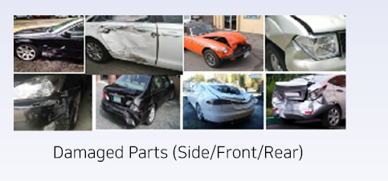
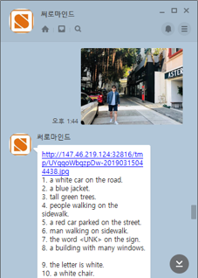
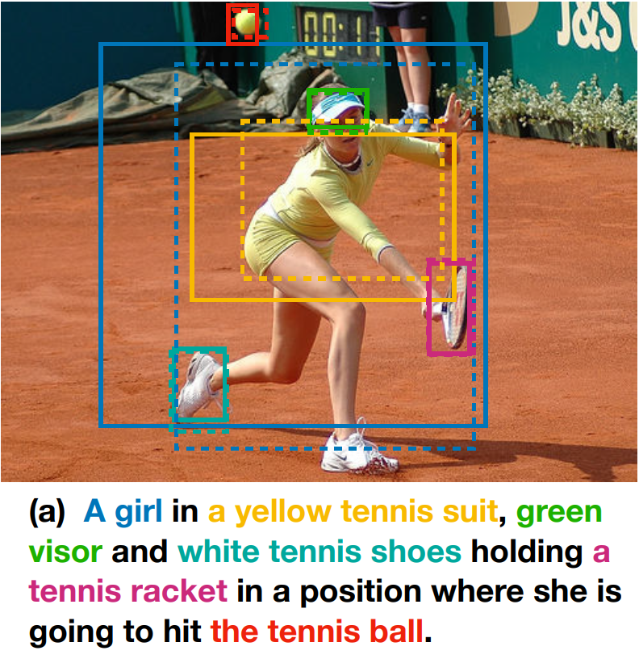
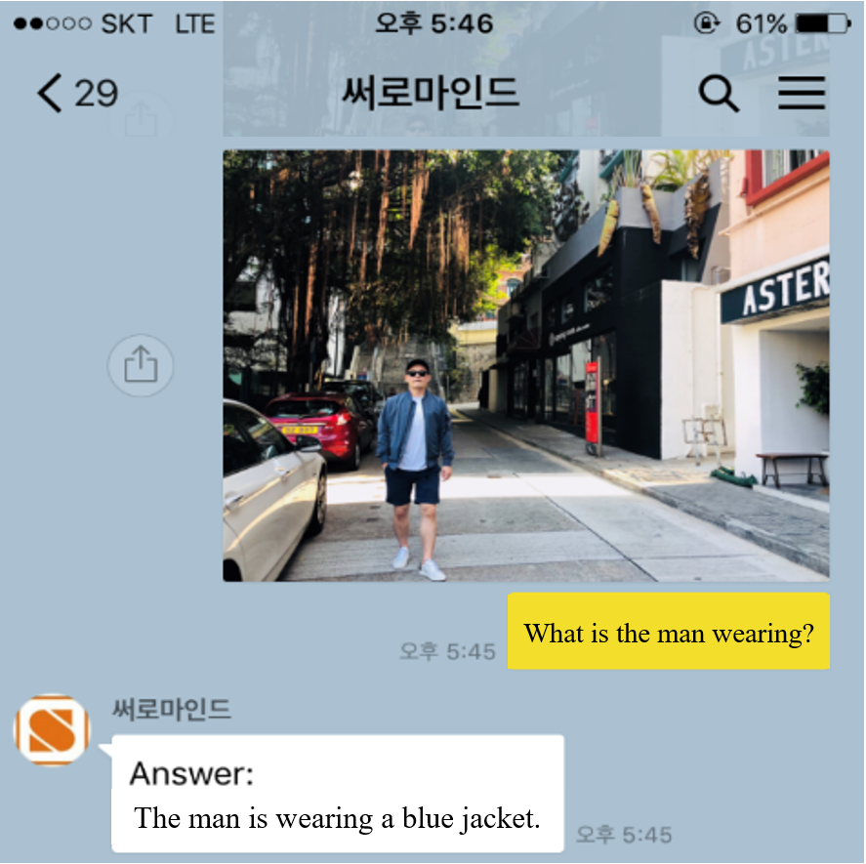
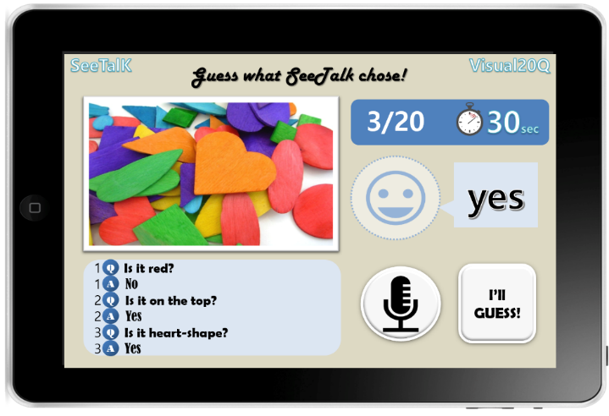
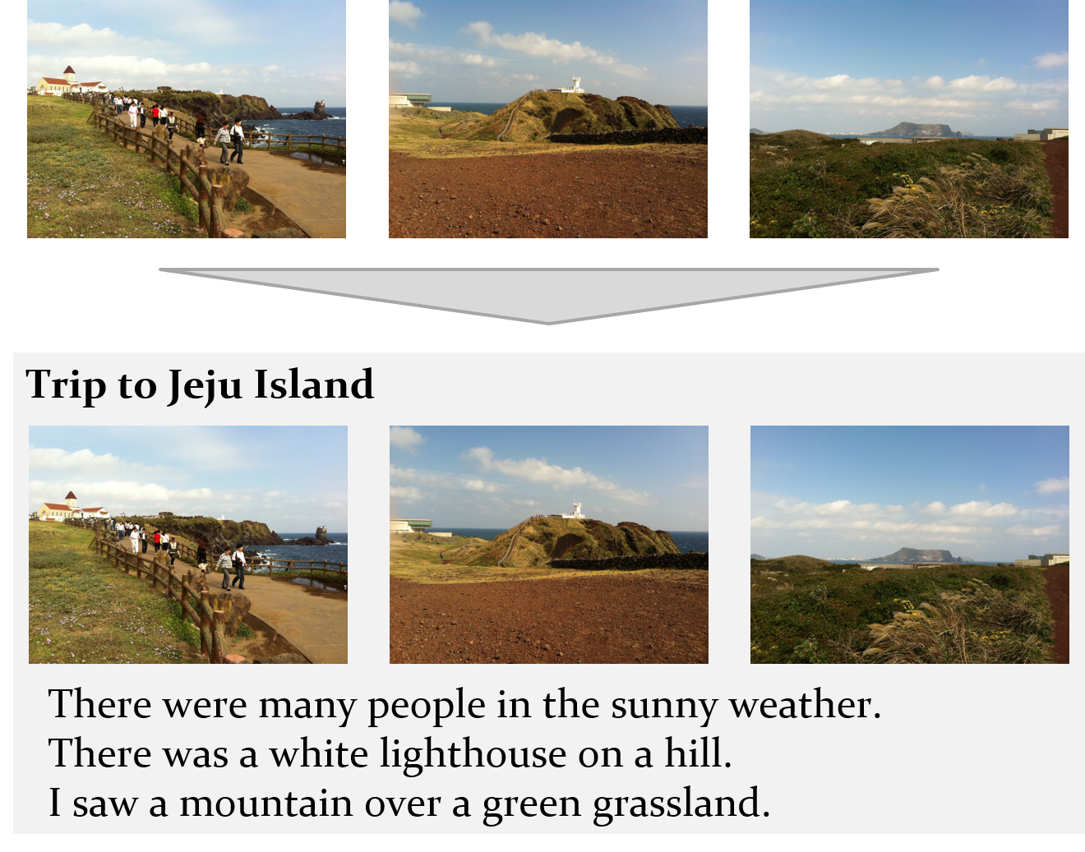
Vision-centric solution including essential microservices to convert visual information into linguistic information
More effective business with analytics of image big data
Linguistic information from images helps to interact with users
Image Detection & Classification
Detecting objects and classifying images
Powerful classification solutions for objects, scenes, and events
Customization services for your specific classification problems
Image Labeling & Description
Extracting keywords and phrases that express the contents of the image
Visual Question Answering
Answering short-answer questions about the contents of the picture
Visual Storytelling
Writing a story for a series of images
Identifying and expressing story elements such as characters, subjects, and events in images
Supporting tool for digital storytelling with images

Slide 2
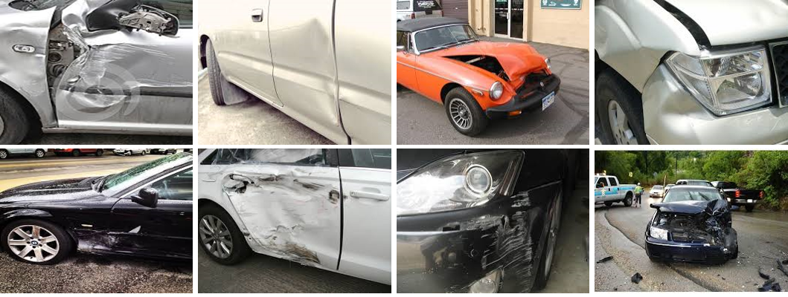
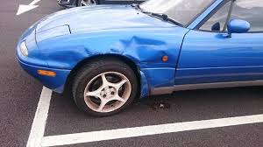
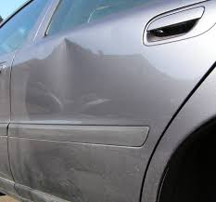
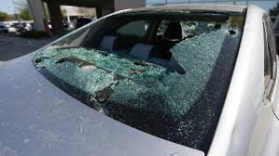
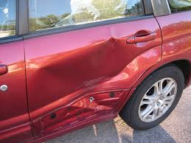
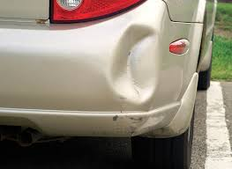
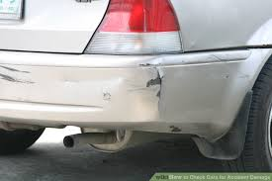
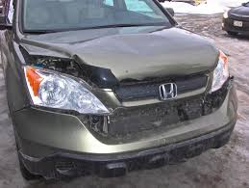
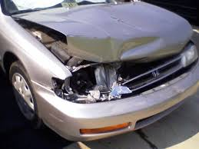
Vision-centric solution including essential microservices to convert visual information into linguistic information
More effective business with analytics of image big data
Linguistic information from images helps to interact with users
Image Detection & Classification
Detecting objects and classifying images
Powerful classification solutions for objects, scenes, and events
Customization services for your specific classification problems (ex: damaged parts or the damage level of a car)
Image Labeling & Description
Extracting keywords and phrases that express the contents of the image
Matching texts to corresponding image parts
Generating descriptive texts in specific styles for an image
Visual Question Answering
Answering short-answer questions about the contents of the image
Interactive question-answering on given images for specific goals
Answering based on encyclopedic information
Visual Storytelling
Writing a story for a series of images
Identifying and expressing story elements such as characters, subjects, and events in images
Supporting tool for digital storytelling with images

